Slide 1







Presented by Boloram Mitra
HR Data Analysis using SQL

Slide 2
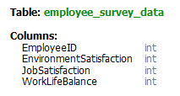
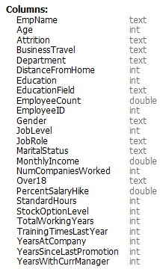

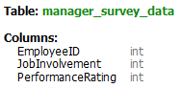
About Dataset
The Dataset has 3 tables as shown

Slide 3
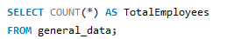


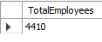
1. Retrieve the total number of employees in the dataset.
OUTPUT :
The Organization have total 4410 Employeees

Slide 4
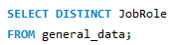
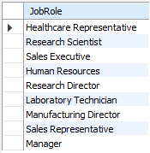

2. List all unique job roles in the dataset.
OUTPUT :
The Organization has 9 unique job roles
Healthcare Representative
Research Scientist
Sales Executive
Human Resources
Research Director
Laboratory Technician
Manufacturing Director
Sales Representative
Manager

Slide 5
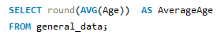

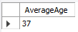
3. Find the average age of employees.
OUTPUT :
The Average age of employees in the Organization is Years
37

Slide 6
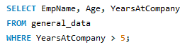
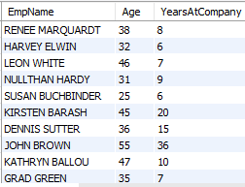
4. Retrieve the names and ages of employees who have worked at the company for more than 5 years.
OUTPUT :
The output shows the Employee Names along with their Age and Years in the company

Slide 7
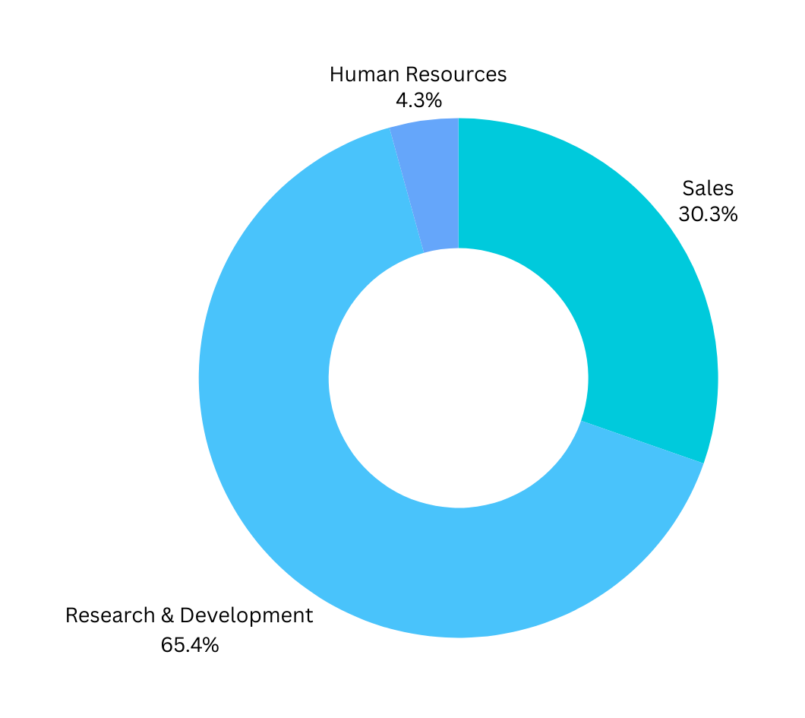
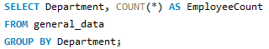
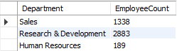
5. Get a count of employees grouped by their department.
OUTPUT :
The chart shows the company has 65.4% of employees in R&D department

Slide 8
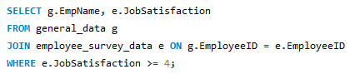
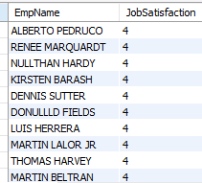
6. List employees who have 'High' Job Satisfaction.
OUTPUT :
The output shows the Name of the Employees who have job satisfaction level 4 or higher

Slide 9
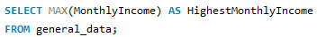
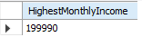
7. Find the highest Monthly Income in the dataset.
OUTPUT :
The output retrieves the Highest Monthly Income from the database which is 1,99,990 INR

Slide 10
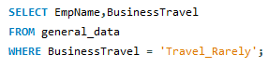
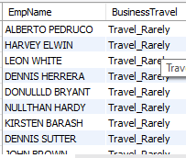
8. List employees who have 'Travel_Rarely' as their BusinessTravel type.
OUTPUT :
From the query we got the output which shows the Name of the Employees who Travel Rarely for their job.

Slide 11
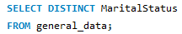
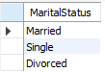
9. Retrieve the distinct MaritalStatus categories in the dataset.
OUTPUT :
The Result shows, there are 3 Marital Status employees have listed : Married, Single & Divorced

Slide 12
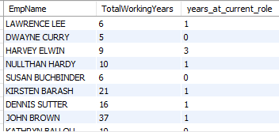
10. Get a list of employees with more than 2 years of work experience but less than 4 years in their current role.
OUTPUT :
The List shows the Name of the Employees who have experience more than 6 years but working for less than 4 years in the current role.

Slide 13
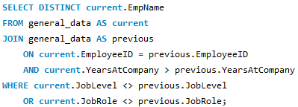
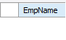
11. List employees who have changed their job roles within the company (JobLevel and JobRole differ from their previous job).
OUTPUT :
There is no result found in the database matching such conditions

Slide 14
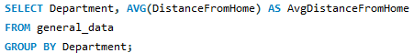
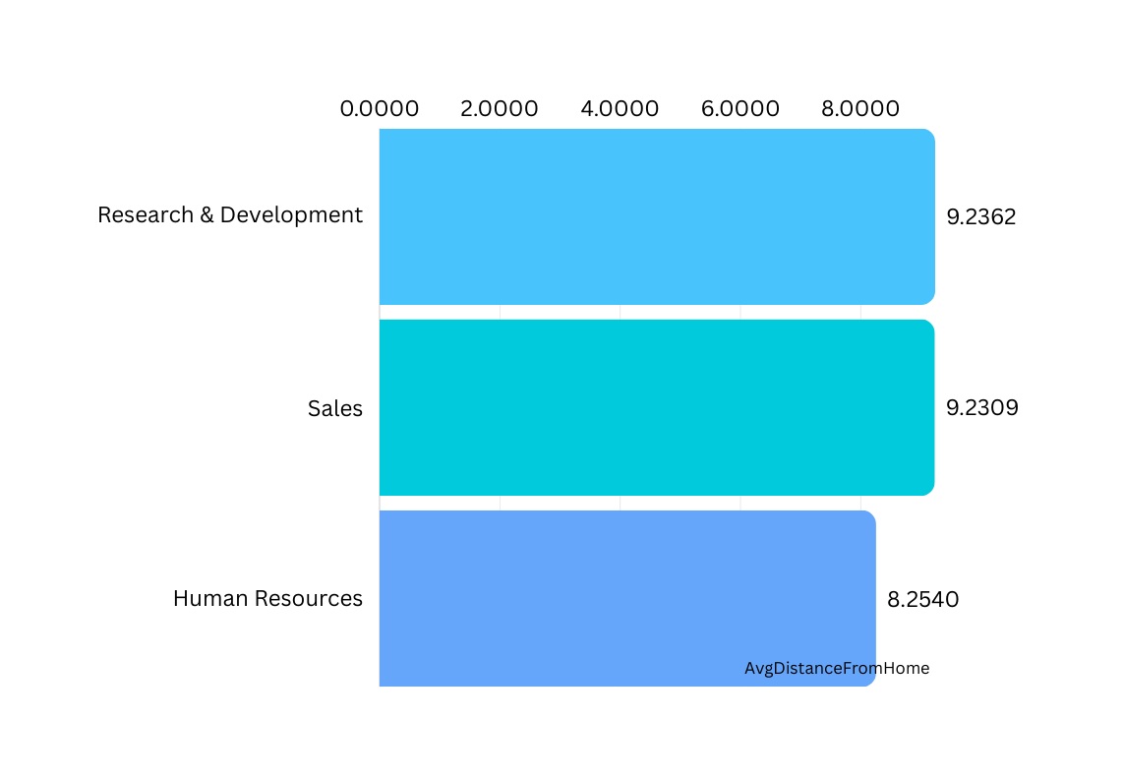
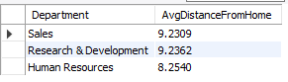
12. Find the average distance from home for employees in each department.
OUTPUT :

Slide 15
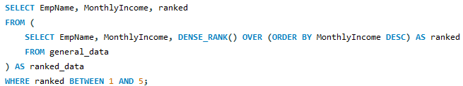
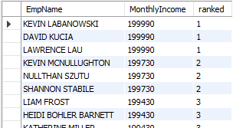
13. Retrieve the top 5 employees with the highest MonthlyIncome.
OUTPUT :
As many employees have same salary, The query retrieves the top 5 salaries along with the name of the employees who are getting it.

Slide 16
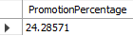
14. Calculate the percentage of employees who have had a promotion in the last year.
OUTPUT :
The data shows the 24.28% of employees got promoted last year

Slide 17
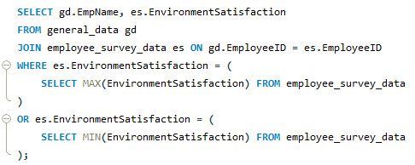
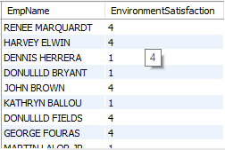
15. List the employees with the highest and lowest Environment Satisfaction.
OUTPUT :
The output shows the name of the employees who have highest & lowest Environment Satisfaction levels

Slide 18
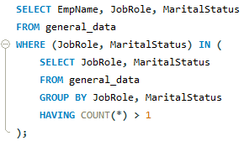
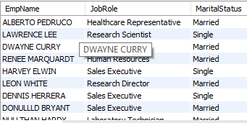
16. Find the employees who have the same JobRole and MaritalStatus.
OUTPUT :
The output shows the list of the employees who have same Job Role and Marital Status

Slide 19
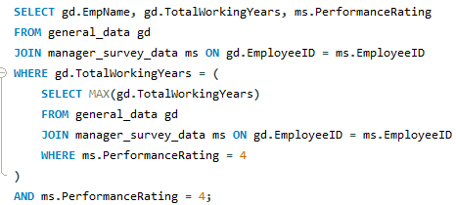
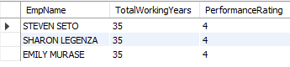
17. List the employees with the highest TotalWorkingYears who also have a PerformanceRating of 4.
OUTPUT :
The query retrieves the Employee Names who have highest total working years & performance rating of 4

Slide 20
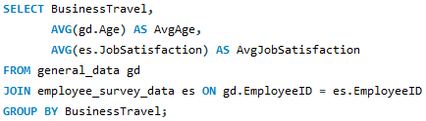
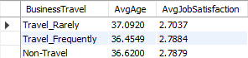
18. Calculate the average Age and JobSatisfaction for each BusinessTravel type.
OUTPUT :
The query retrieves the Average Age & Average Job satisfaction level, categorized by BusinessTravel type.

Slide 21
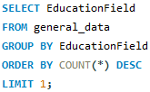
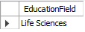
19. Retrieve the most common EducationField among employees.
OUTPUT :
The query shows that the Most Common Education field in the database is ‘Life Sciences’.

Slide 22
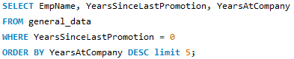
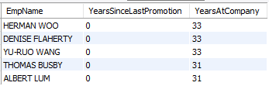
20. List the top 5 employees who have worked for the company the longest but haven't had a promotion.
OUTPUT :
The output shows the top 5 employees who have worked for longest period but haven’t got any promotion yet.

Slide 23
Conclusion
In this project, we conducted a comprehensive analysis of an employee dataset using SQL queries to extract key insights. We explored various aspects of the workforce, including demographics, job details, satisfaction levels, performance ratings, career progression, and financial metrics.
Our findings highlighted trends such as employee demographics, job satisfaction, career advancement, and financial distribution. We identified top performers, employees with extensive experience, and those with high job satisfaction. These insights provide valuable information for strategic decision-making in talent management, workforce planning, and employee engagement initiatives.
While the analysis provided valuable insights, it's important to acknowledge limitations such as potential data inconsistencies and missing information. Future research could explore longitudinal trends and external factors impacting employee dynamics.
Overall, this project demonstrates the power of data-driven approaches in understanding and optimizing workforce management practices to drive organizational success.

Slide 24

Presented by : Boloram Mitra
Thank you very much!

